Slide 1
The Rady School of Management
MGT 167 • Winter 2024
Social Entrepreneurship: Doing Well by Doing Good
Wednesday, March 6

Slide 2
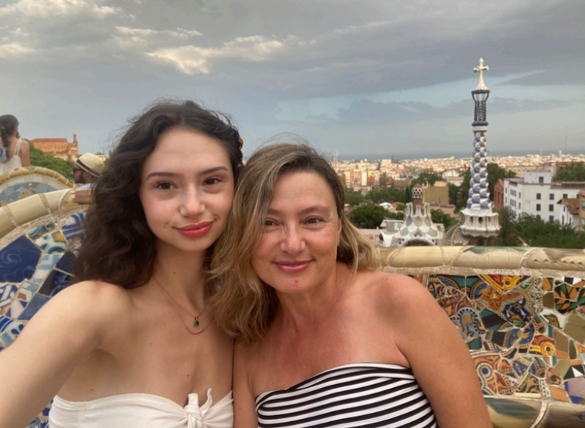
Feedback from March 4
Awesome impromptu speaker.
Incredibly inspiring!
Nika’s family is cool as heck.
Agility and flexibility.
Attitude!
Don’t be disheartened.
Natalie’s mom’s story is similar to my own family’s.
Today was jam-packed but I really loved hearing from Nika’s mom.
Really enjoyed hearing from our surprise guest speaker.
She spoke very clearly and answered questions really well.
I loved her point not to sacrifice the things that bring you joy.
If her family can overcome so much adversity, and still accomplish so much, I have no excuses.

Slide 3
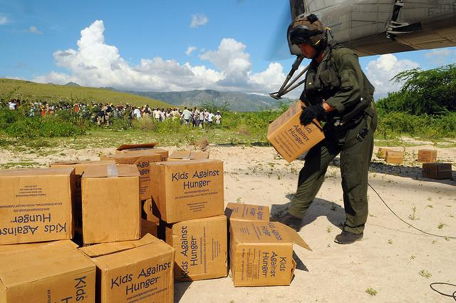
Feedback from March 4
Poverty.Inc was impactful and eye-opening.
The documentary surprised me… I thought we were helping poor people in Africa…but in fact, we’re destroying their ability to make a living.
Interesting to see how good intentions can turn out so bad.
Poverty.Inc was shocking but interesting to see a different perspective of Haiti.
I had previously viewed global aid positively, but Poverty.Inc was a different story. Interesting to learn about faith-based NGO’s. People give what they want, not what is needed. How much time and energy have been wasted because of this!
There are a lot of opportunities to work for peace in government jobs.
I really liked that we discussed foreign aid.
Now I know more about how much aid is being given by US to Ukraine and rest of the world.
Enjoyed including current events in classroom discussion.
Transportation– getting stuff there– is critical. It can be dangerous.
The quote ”security is like oxygen…” really stood out to me.
It’s sad that Cambodian kids were being used to shake down tourists for money.
I am surprised ESG is now “old news.”

Slide 4
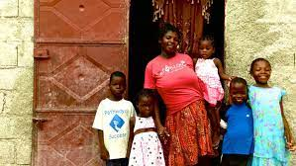
Poverty.Inc
“…what can you do individually to change the situation? The movie made me think that I don’t want to give my money to charities. What’s the solution?”
* Due diligence
* Volunteer
* Follow your passion, not the crowd
* Despair not! There are many agencies doing wonderful work. You can help make the world a better place. And make a good living by doing it.

Slide 5
Poverty. Inc Review Monday, 4 Mar Ppt.
Paternalism is no match for partnership
Create jobs, don’t send free stuff
Short term natural disaster turns into long-term un-natural disaster
Haiti (Republic of NGOs) has most in world (10,000+)
Local economy must compete with NGO’s free stuff
Creates dependency mentality, demoralizes local people
“NGO’s should provide the rod, teach how to fish, then GO HOME.”
“If you’re still here 40 years from now, something is wrong”
Foreign Aid has become the cornerstone for engagement in the Third World
NGO’s include consultants and contractors
U.S. military interface with NGO’s in war zones
Transportation (distribution) can be a huge challenge

Slide 6
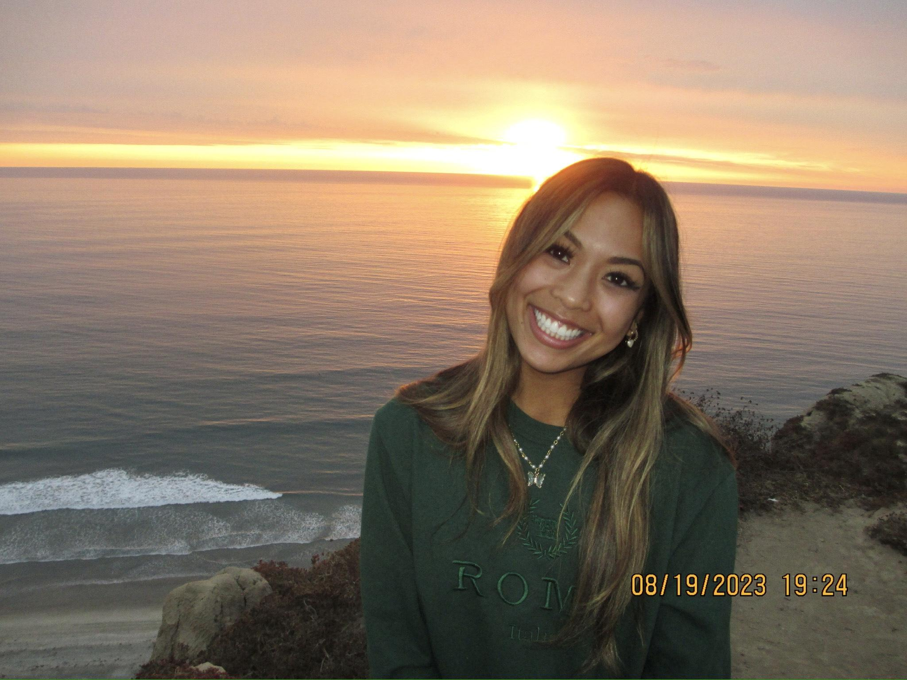
News of the Day Maya Ordonez Bridgit Mendler Northwood Space start-up

Slide 7
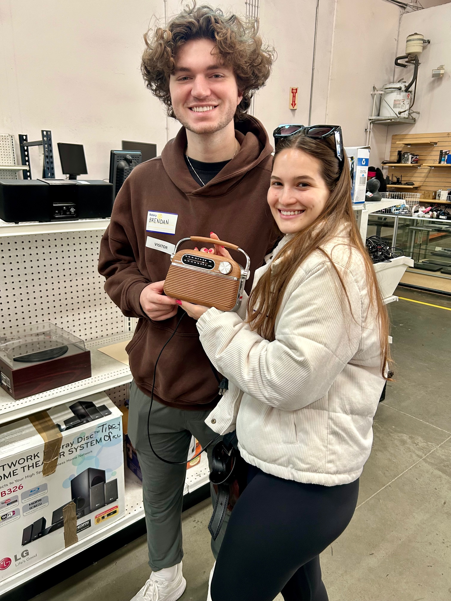
News of the Day Sofia Quiroz-kuhner Chemical recycling

Slide 8

Progress Exam #3
Due Monday, Mar 11 before 11:00 am, open 24-hrs in advance
20 questions on Canvas
20 min. timed
T-F and Multiple Choice
Open book, open source
Covers material Feb 26 through today, March 6
Topics and # of questions
Emerging 4th sector 4
IGO, NGO 4
Poverty.Inc 3
IRC (Amer Jawabreh) 2 2
Neal Bloom 2
WSJ 2
SDBJ Book of Lists 2
Soccket video 1

Slide 9
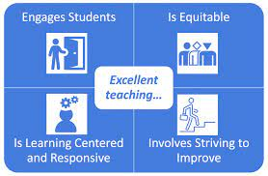
Student Evaluation of Teaching
SET surveys now open (Mar 4-16)
Important to UC San Diego, Rady School of Management and Me!
Available on Evaluations site
Holistic Teaching Evaluation Oversight Committee

Slide 10
Networking Papers Scattergram
Grade #
A 20
A- 20
B+ 11
B 14
B- 1
C+ 16
C 1
D 3
F 1

Slide 11

Networking Papers original guidance
A
Early start
Ambitious goal “Dream Big”
Overcome obstacles
Face-to-face interview
B
Same as above, but not a stretch
C
Success, but reliance on e-mail
#1 reason for lower grade…
procrastination

Slide 12
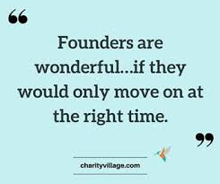
Next Class Monday, March 11 Crisis Communications Founders Disease
Debt and Disputes Cloud future of Iconic Church
SSIR Strong Boards
What’s a good company to do?
WSJ June 6, 2023 Companies That Embraced Social Issues

Slide 13
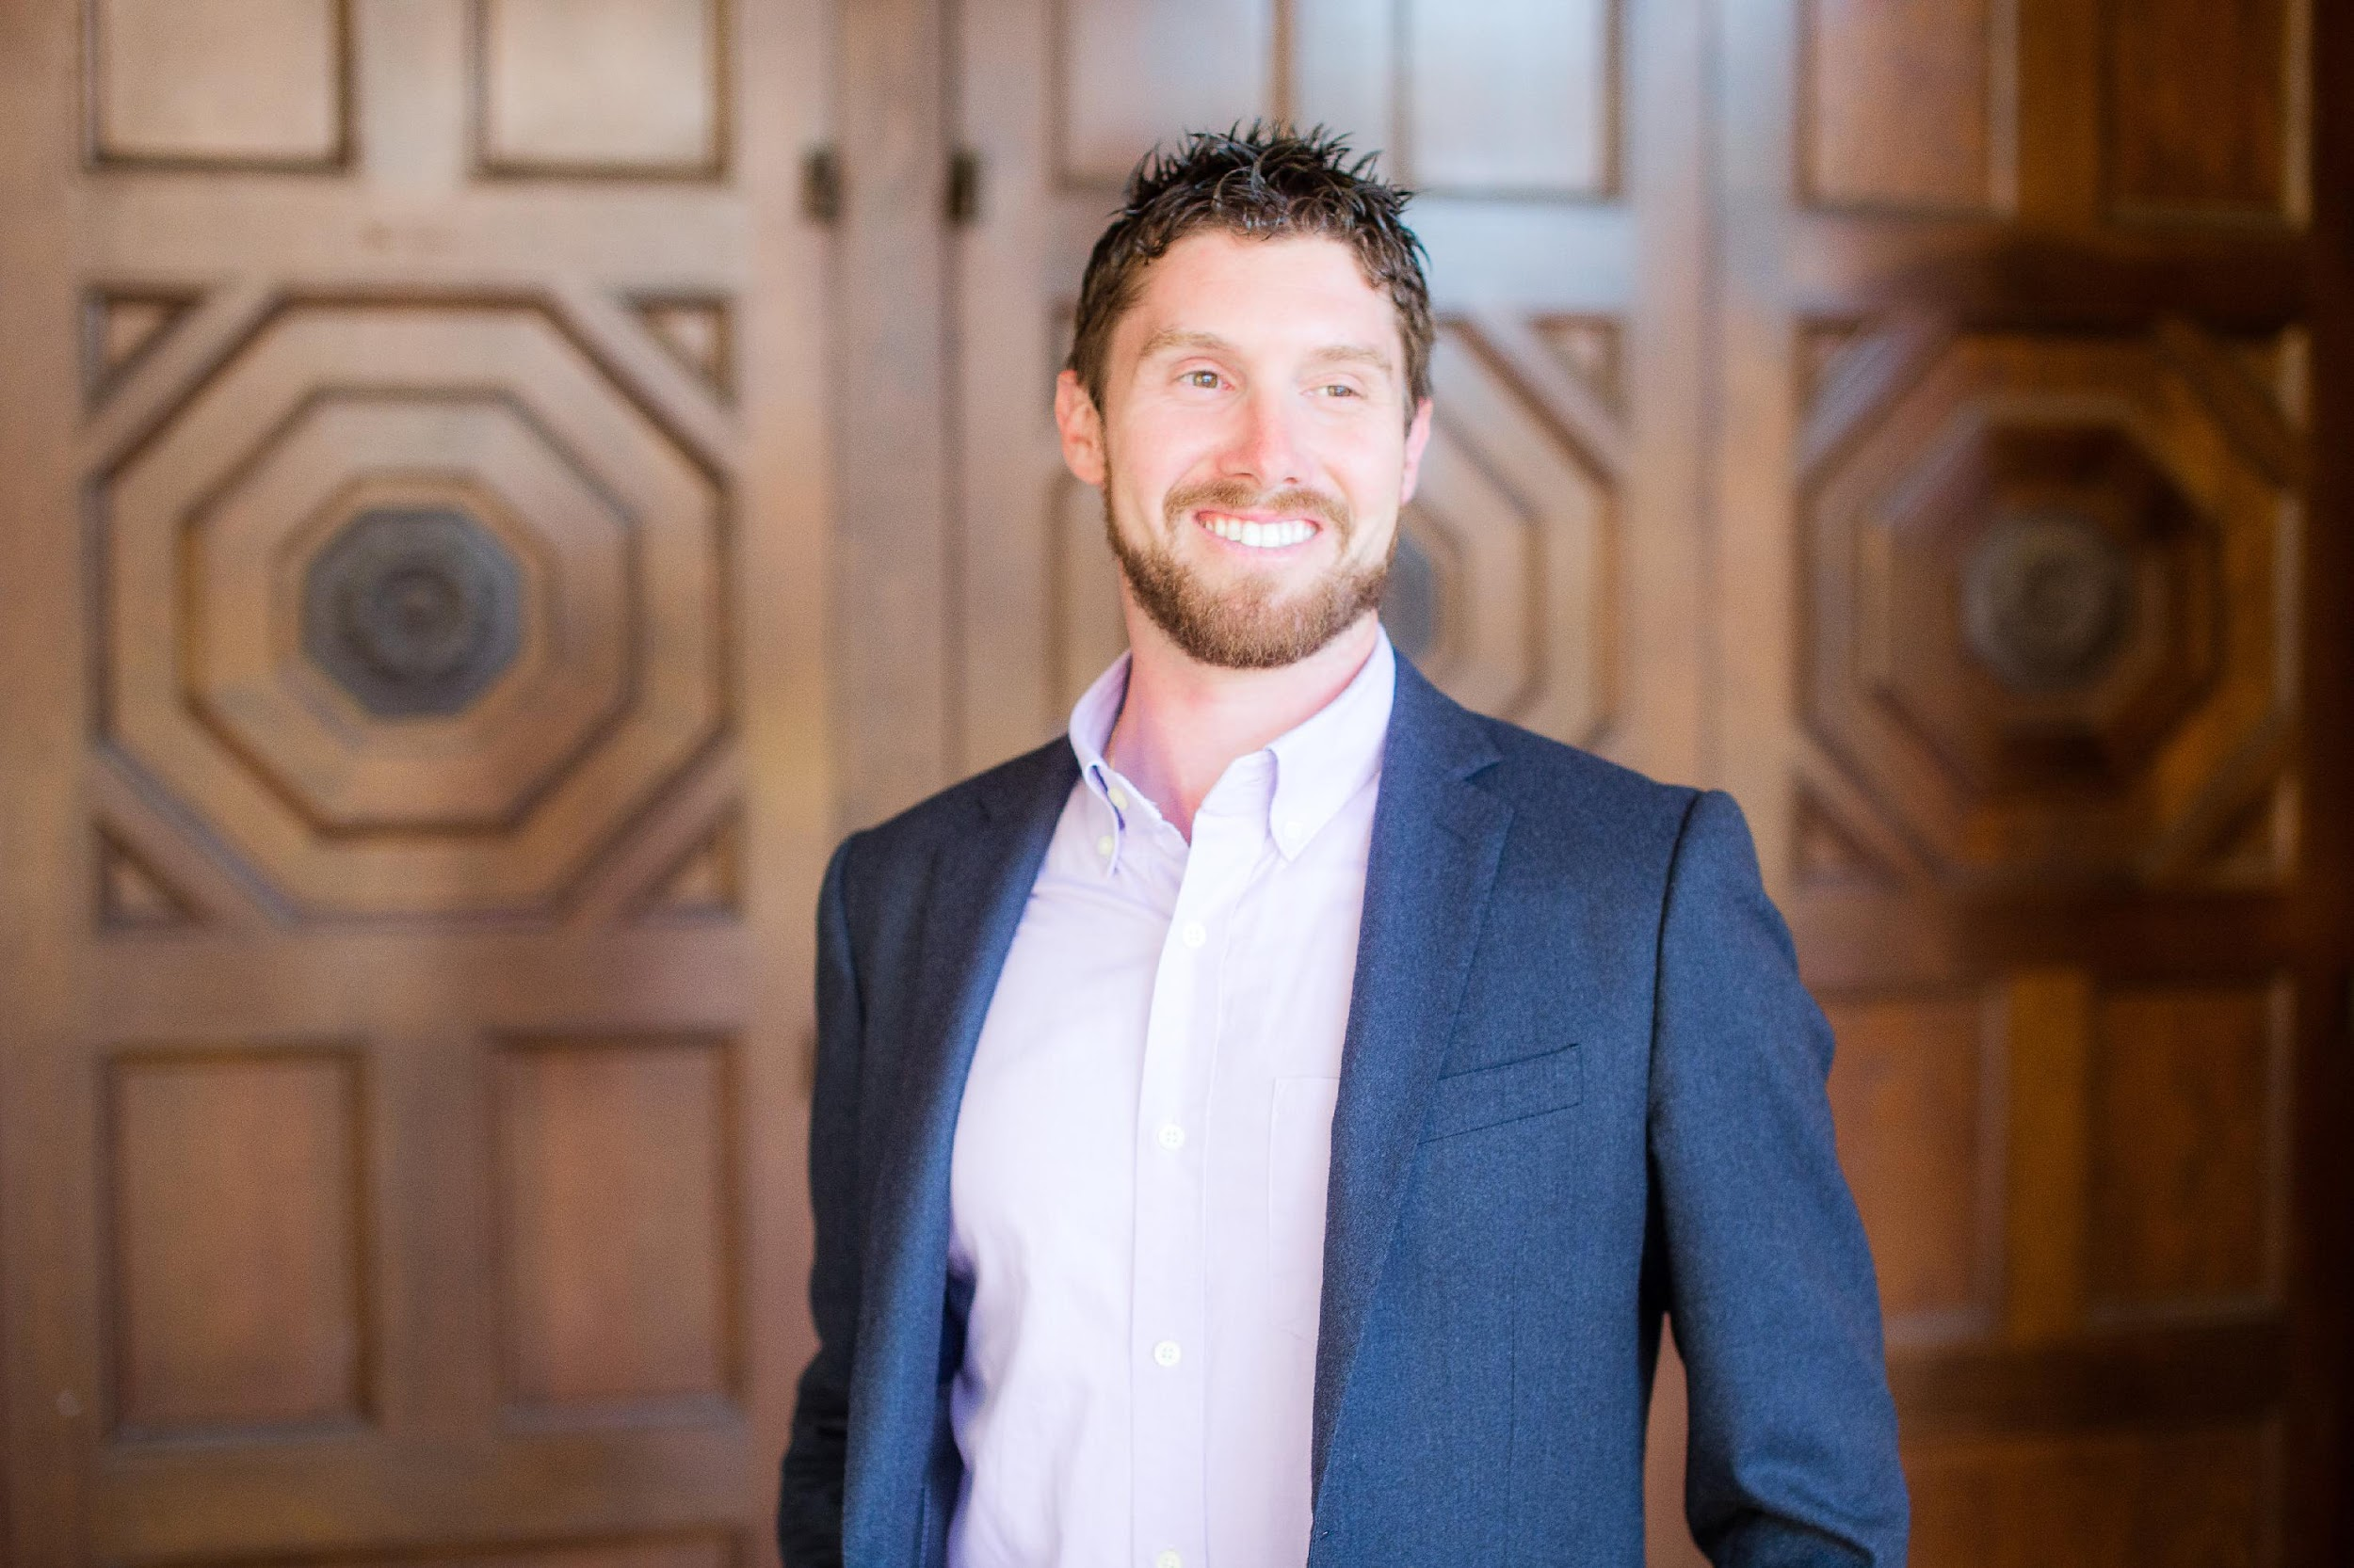

Guest Speaker: Neal Bloom Rising Tide Partners
Student Hosts:
Nika Herous, Emmie Kwong, Carter Schrader

Slide 14
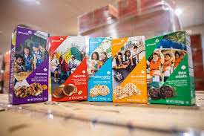
Drawing for Girl Scout Cookies

